Slide 1
Chapter 3
Describing Syntax and Semantics

Slide 2
Chapter 3 Topics
Introduction
The General Problem of Describing Syntax
Formal Methods of Describing Syntax
Attribute Grammars
Describing the Meanings of Programs: Dynamic Semantics
3-‹#›

Slide 3
3.1 Introduction
Syntax: The syntax of a programming language is the form or structure of the expressions, statements, and program units.
Semantics: The semantics is the meaning of the expressions, statements, and program units.
e.g., while statement in Java
while (boolean_expr) statement
Syntax and semantics provide a language’s definition
Users of a language definition
Other language designers
Implementers
Programmers (the users of the language)
3-‹#›

Slide 4
3.2 The General Problem of Describing Syntax: Terminology
A sentence is a string of characters over some alphabet
A language is a set of strings of characters from some alphabet.
Formal description of the syntax of programming languages often do not include the description of lexemes.
A lexeme is the lowest level syntactic unit of a language (e.g., *, sum, begin). The lexemes of a programming language include its numeric literals, operators, and special words, among others. Each lexeme group is represented by a name or token.
A token of a language is a category of lexemes.
e.g. index = 2 * count + 17
Lexemes Tokens
index identifier
= equal_sign
2 int_literal
* mult_op
count identifier
+ plus_op
17 int_literal
; semicolon
3-‹#›

Slide 5
In general, languages can be formally defined in two distinct ways: by recognition and by generation.
Language Recognizers accept a Language. Recognizers are Machines. M: Machine; L: Language; S: String;
Machines take a string as input. The Machine will accept the input when it runs, the Machine stops at an accept state.
If M recognizes all S in L, M is said to accept S.
Otherwise M is said to reject S. S is in L if and only if M accepts S. Example: syntax analysis part of a compiler (Details -> Chapter 4 )
Language Generators create the strings of a Language. Generators are string constructors. A generator provides a construction description. If a generator is able to construct all stings in a Language L, and every string S that can be constructed by that generator is in L, we can say that the generator is a generator for the language L. If there is no way to construct a string S from the generator, S is not in L. Context Free Grammars (CFGs) are a well known type of language generators. Push Down Automatas (PDAs) are a well known form of language recognizers. CFGs generate the same class of languages that are recognized by PDAs.
3-‹#›

Slide 6
3.3 Formal Methods of Describing Syntax
Context-Free Grammars (CFGs)
Developed by Noam Chomsky in the mid-1950s
Language generators, meant to describe the syntax of natural languages
Define a class of languages called context-free languages
Backus-Naur Form (1959) or Backus Normal Form (BNF)
Invented by John Backus to describe Algol 58
BNF is equivalent to context-free grammars
3-‹#›

Slide 7
BNF Fundamentals
A metalanguage is a language used to define other languages. BNF is a metalanguage for programming languages.
A grammar is a metalanguage used to define the syntax of a language.
Our interest : using grammars to define the syntax of a programming language.
BNF uses abstractions for syntactic structures, which act like syntactic variables (also called nonterminal symbols, or just nonterminal )
e.g., Java assignment statement can be given by
<assign> → <var> = <expression>
abstraction to definition of LHS
be defined
3-‹#›

Slide 8
BNF rule (or production): It is a definition of an abstraction. Its rule has a left-hand side (LHS), which is a nonterminal, and a right-hand side (RHS), which is a string of terminals and/or nonterminals
Terminals are lexemes or tokens
Nonterminals are often enclosed in angle brackets
e.g., BNF rules:
<if_stmt> → if( <logic_expr> ) <stmt>
<if_stmt> → if( <logic_expr> ) <stmt> else <stmt>
or with the rule
<if_stmt> → if( <logic_expr> ) <stmt>
| if( <logic_expr> ) <stmt> else <stmt>
Describing lists:
<ident_list> → identifier | identifier, <ident_list>
3-‹#›

Slide 9
Grammars and Derivations
Grammar: a finite non-empty set of rules
A derivation is a repeated application of rules, starting with the start symbol and ending with a sentence (all terminal symbols)
3-‹#›

Slide 10
Example 3.1 A Grammar for a Small Language
<program> → begin <stmt_list> end
<stmt_list> → <stmt> | <stmt> ; <stmt_list>
<stmt> → <var> = < exprssion >
<var> → A | B | C
<exprssion> → <var> + <var>
| <var> - <var>
| <var>
3-‹#›

Slide 11
An Example Derivation
<program> => begin <stmt_list> end
=> begin <stmt> ; <stmt_list> end
=> begin <var> = <exprssion>; <stmt_list> end
=> begin A = <exprssion>; <stmt_list> end
=> begin A = <var> + <var> ; <stmt_list> end
=> begin A = B + <var> ; <stmt_list> end
=> begin A = B + C ; <stmt_list> end
=> begin A = B + C ; <var> = <exprssion>; end
=> begin A = B + C ; B = <exprssion>; end
=> begin A = B + C ; B = <var>; end
=> begin A = B + C ; B = C; end
3-‹#›

Slide 12
Derivations
Sentential form: Every string of symbols in a derivation, including <program> is a sentential form.
Generated sentence: A sentential form that has only terminal symbols.
Leftmost derivation: A derivation in which the leftmost nonterminal in each sentential form is expanded
A derivation may be neither leftmost nor rightmost
3-‹#›

Slide 13
Example 3.2 A Grammar for Simple Assignments
<assign> → <id> = <expr>
<id> → A | B | C
<expr> → <id> + <expr>
| <id> * <expr>
| ( <expr> )
| <id>
3-‹#›

Slide 14
A = B * (A + c)
is generated by leftmost derivation:
<assign> => <id> = <expr>
=> A = <expr>
=> A = <id> * <expr>
=> A = B * <expr>
=> A = B * ( <expr> )
=> A = B * (<id> + <expr> )
=> A = B * (A + <expr> )
=> A = B * (A + <id> )
=> A = B * (A + C )
3-‹#›

Slide 15
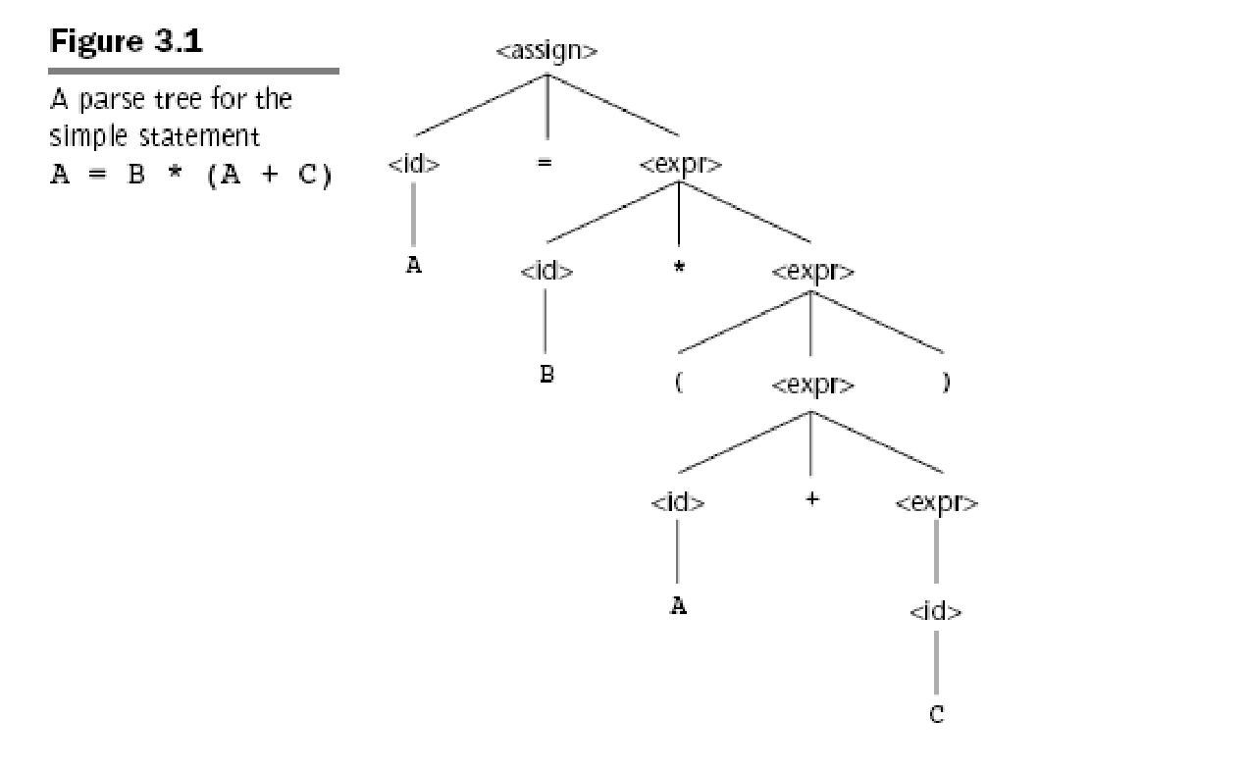
Parse Tree
A hierarchical representation of a derivation
Every internal node is labeled with a nonterminal symbol;
Every leaf is labeled with a terminal symbol.
3-‹#›

Slide 16
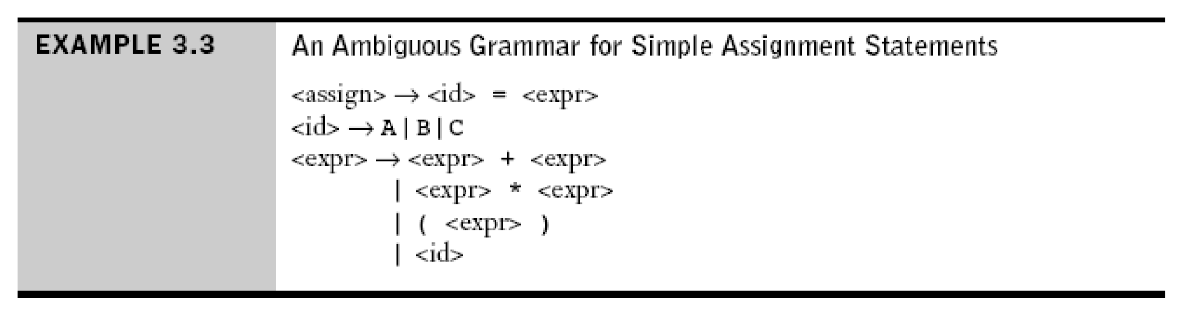
Ambiguity in Grammars
A grammar is ambiguous if and only if it generates a sentential form that has two or more distinct parse trees
3-‹#›

Slide 17
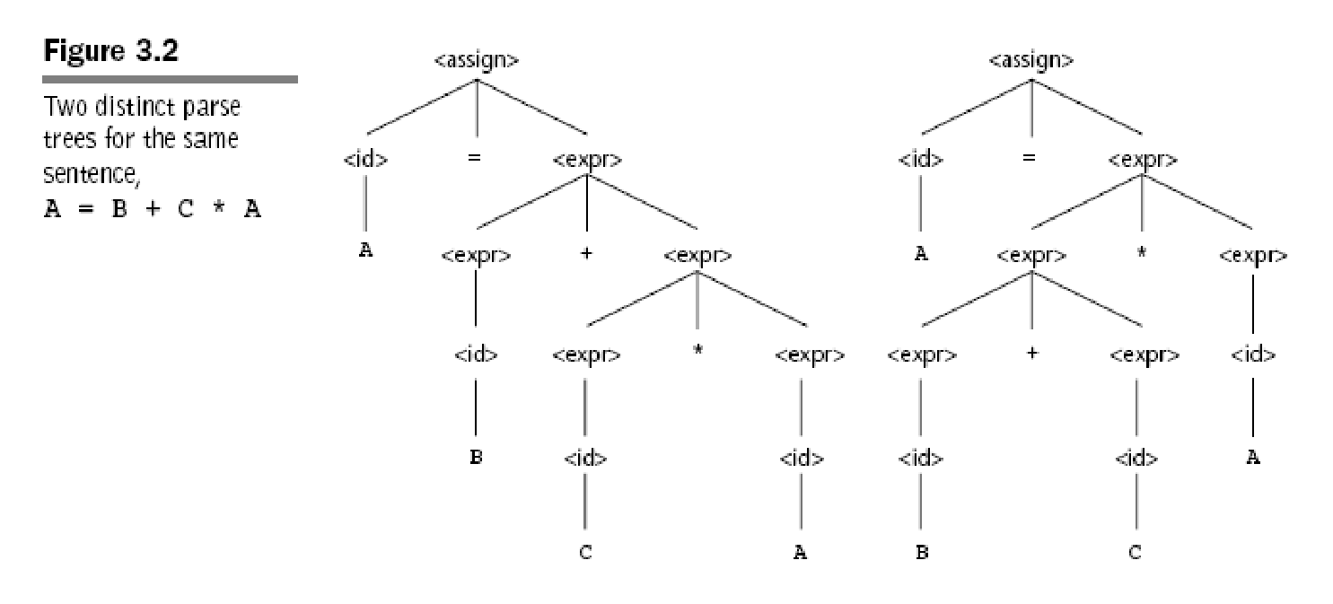
Operator which is generated lower in parse tree, has precedence over operators which are generated higher in the parse tree.
3-‹#›

Slide 18
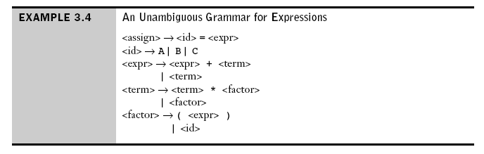
An Unambiguous Expression Grammar
3-‹#›

Slide 19
Using the grammar in Example 3.4,
A = B + C * A
is derived as:
<assign> => <id> = <expr>
=> A = <expr>
=> A = <expr> + <term>
=> A = <term> + <term>
=> A = <factor> + <term>
=> A = <id> + <term>
=> A = B + <term>
=> A = B + <term> * <factor>
=> A = B + <factor> * <factor>
=> A = B + <id> * <factor>
=> A = B + C * <factor>
=> A = B + C * <id>
=> A = B + C * A
3-‹#›

Slide 20
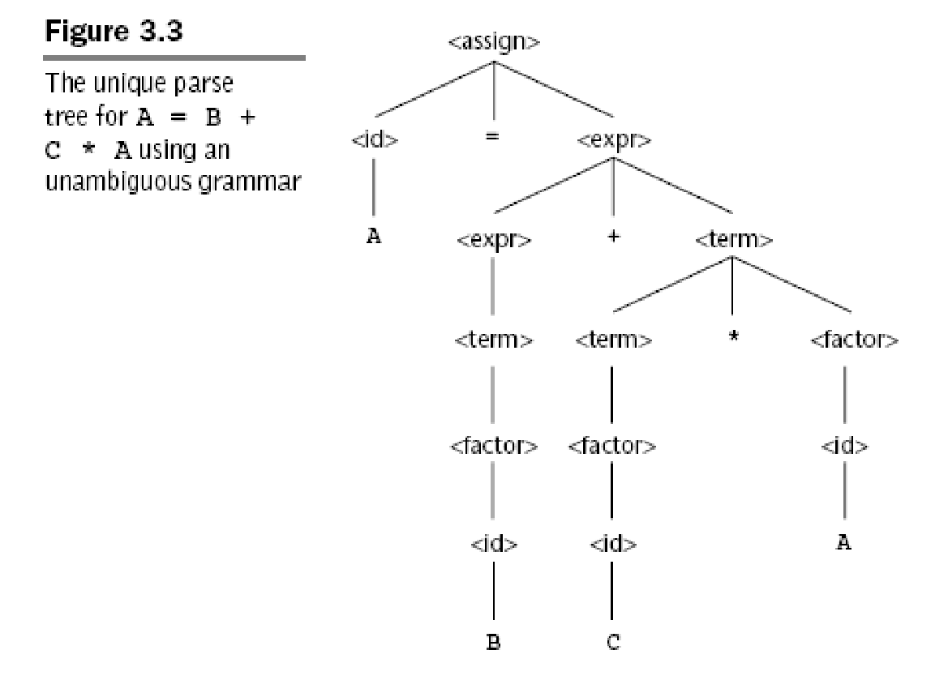
3-‹#›

Slide 21
Associativity of Operators
Associativity: A semantic rule to specify which operator should have precedence.
Example: Parse tree for
A = B + C + A
is shown in Figure 3.4, by using grammar in Example 3.4.
3-‹#›

Slide 22
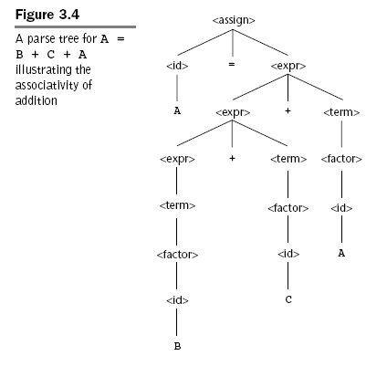
3-‹#›

Slide 23
Integer addition is associative, i.e.,
(A + B) + C = A + (B + C)
Floating-point addition is not associative.
e.g., 1.0+1.0+…+1.0+ 1.0x10 =1.000001x10
1.0x10 +1.0+1.0+…+1.0 =1.000000x10
Subtraction and division are not associate.
7
7
11
7
7
11
3-‹#›

Slide 24
Left Recursive vs Right Recursive
Left recursive: When a grammar rule has its LHS also appearing at the beginning of its RHS, the rule is said to be left recursive. e.g., N = N a
Left recursive specifies left associativity. Rules in Example 3.4 make both addition and multiplication left recursive.
Left recursive disallows the use of some important syntax analysis algorithms.
Right recursive: If LHS appears at the right end of RHS, the rule is said to be right recursive. Ex.1, N=a N
Ex.2 BNF to describe exponetiation
<factor> → <exp> ** <factor> | <exp>
<exp> → ( <expr> ) | <id>
3-‹#›

Slide 25
3.3.2 Extended BNF (EBNF)
BNF:
recursion for iteration
nonterminals for grouping
EBNF: additional metacharacters
{ } for a series of zero or more
( ) for a list, must pick one
[ ] for an optional list; pick none or one

Slide 26
Three extensions in EBNF
First, optional parts of an RHS are placed in brackets [ ].
e.g., <if_stmt> → if (<expr>) <stmt> [else <stme>]
Second, repetitions (0 or more) are placed inside braces { }
e.g., <ident_list> → <identifier> {, <identifier> }
Third, alternative parts of RHSs are placed inside parentheses and separated via vertical bars
e.g., <term> → <term> (* | / | %) <factor>
3-‹#›

Slide 27
BNF and EBNF
BNF <expr> → <expr> + <term>
| <expr> - <term> | <term>
<term> → <term> * <factor>
| <term> / <factor> | <factor>
<factor> → <exp> ** <factor> | <exp>
<exp> → (<expr>) | <id>
EBNF
<expr> → <term> {(+ | -) <term>}
<term> → <factor> {(* | /) <factor>}
<factor> → <exp> {**<exp>}
<exp> → (<expr>) | <id>
3-‹#›

Slide 28
Recent Variations in EBNF
Alternative RHSs are put on separate lines
Use of a colon (::=) instead of =>
Use of _{opt} for optional parts
Use of oneof for choices
e.g., AssignmentOperator → one of = *= /= %= += -= <<= >>= &= |= ̂=
3-‹#›

Slide 29
3.4 Attribute Grammars (AGs)
An attribute grammar is a device used to describe more of the structure of a programming language than can be described with a CFG. It is an extension to a CFG.
Attribute grammars (AGs) have additions to CFGs to carry some semantic info on parse tree nodes
3-‹#›

Slide 30
3.4.1 Static Semantics
The static semantics defines restrictions on the structure of valid texts that are hard or impossible to express in standard syntactic formalisms. For compiled languages, static semantics essentially include those semantic rules that can be checked at compile time.
Examples include checking that every identifier is declared before it is used (in languages that require such declarations) or that the labels on the arms of a case statement are distinct.
3-‹#›

Slide 31
Context-free grammars (equivalent to BNF) cannot describe all of the syntax of programming languages
For example, in Java, a floating-point value cannot be assigned to an integer type variable, although the opposite is legal.
This restriction can be specified in BNF, but it requires additional nonterminals and rules.
If all of the typing rules of Java were specified in BNF, the grammar would be too large to be useful because the grammar determines the syntax analyzer.
3-‹#›

Slide 32
3.4.2 Basic Concepts
Attribute grammars are context-free grammars to which have been added attributes, attribute computation functions and predicate functions.
Attributes are associated with grammar symbols (the terminal and nonterminal symbols), are similar to variables that they can have values assigned to them.
Attribute computation functions (also called semantic functions) are associated with grammar rules. They are used to specify how attribute values are computed.
Predicate functions, which state the static semantic rules of languages, are associated with grammar rules.
3-‹#›

Slide 33
3.4.3 Attribute Grammars Defined
X: grammar symbol
A(X): a set of attributes associated to X. A(X) consists of two disjoint sets S(X) and I(X).
S(X): Synthesized attributes, are used to pass semantic information up a parse tree.
I(X): Inherited attributes, are used to pass semantic information down and across a parse tree.
Let X₀ → X₁ ... X_{n} be a rule.
Functions of the form S(X₀) = f(A(X₁), ... , A(X_{n})) define synthesized attributes of X₀. The value of a synthesized attribute on a parse tree node depends only on that node’s children node.
Functions of the form I(X_{j}) = f(A(X₀), ... , A(X_{n})), for 1 <= j <= n, define inherited attributes. The value of a inherited attribute on a parse tree node depends only on that node’s parent node, and those of its sibling nodes.
3-‹#›

Slide 34
Attribute Grammars Defined (cont’d)
A Predicate function has the form of a Boolean expression on the union of the attribute set {A(X₀), ... , A(X_{n})} and a set of literal attribute values.
Intrinsic attributes: synthesied attributes of leaf nodes whose values are determined outside the parse tree.
If all the attribute values in a parse tree have been computed, the tree is said to be fully attributed. Although in practice it is not always done this way, it is convenient to think of attribute values as being computed after the complete unattributed parse tree has been constructed by the compiler.
3-‹#›

Slide 35
3.4.5 Attribute Grammars: An Example
This example illustrates how an AG can be used to check the type rules of a simple assignment statement.
A, B, C : variable name, they can be int or real
RHS of the assignment can be a variable or an expression.
When there are two variables on RHS, they need not be same type.
When operand types are not the same, the type of the expression is always real.
When operand types are the same, the type of the expression is that of operand.
The type of LHS must match the type of RHS.
The types of operands in RHS can be mixed, but the assignment is valid only if the target and the value resulting from RHS have the same type.
3-‹#›

Slide 36
Attribute Grammars: An Example (cont’d)
Syntax portion of this example AG is:
<assign> → <var> = <expr>
<expr> → <var> + <var> | <var>
<var> → A | B | C
Attributes for the nonterminals in this example AG are:
actual_type: synthesized attribute for nonterminals <var> and <expr> . It is used to store actual type, int or real. In the case of a variable, the actual type is intrinsic. In the case of an expression, it is determined from the actual types of the child node or children nodes of the <expr> nonterminal.
expected_type: inherited attribute for for nonterminal <expr>. It is used to store the type, int or real, for the expression, as determined by the type of the variable on LHS.
3-‹#›

Slide 37
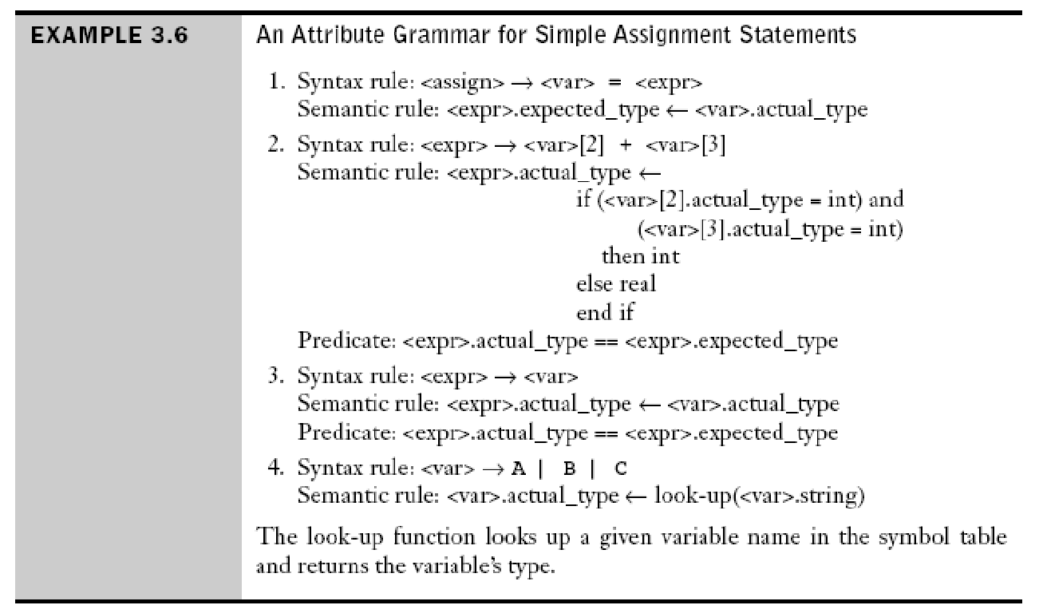
Attribute Grammars: An Example (cont’d)
3-‹#›

Slide 38
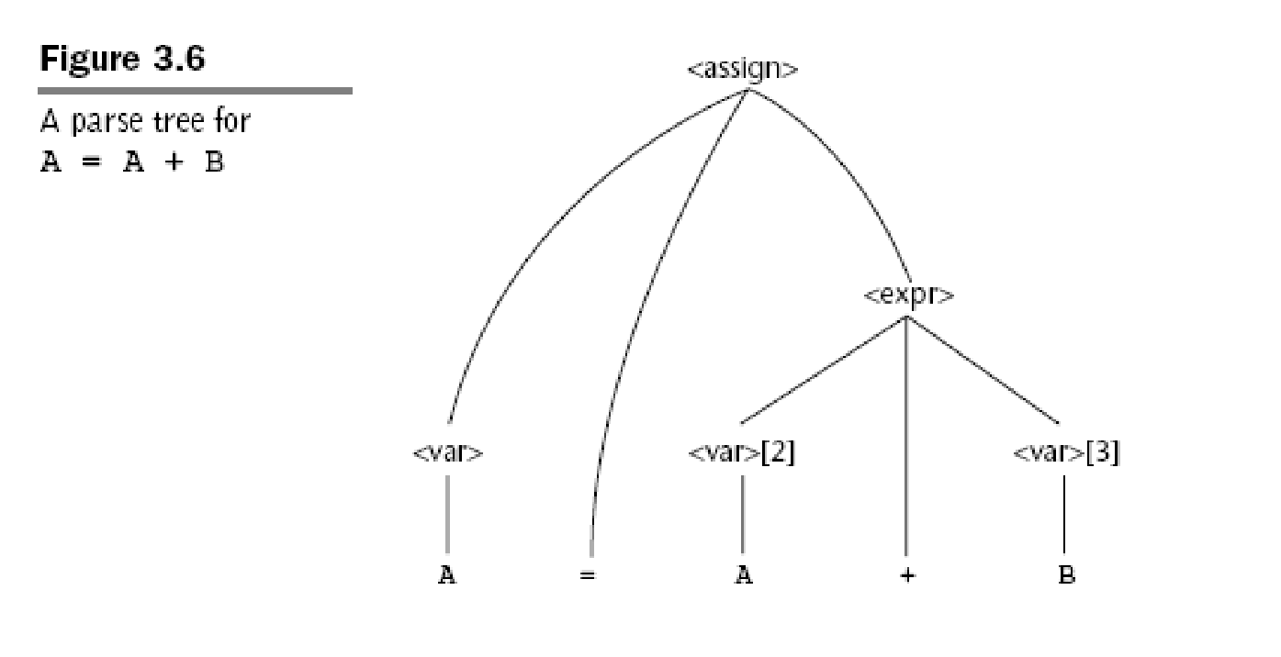
Attribute Grammars: An Example (cont’d)
3-‹#›

Slide 39
Attribute Grammars (continued)
Computing the attribute values of a parse tree is sometimes called decorating the parse tree.
How are attribute values computed?
If all attributes were inherited, the tree could be decorated in top-down order.
If all attributes were synthesized, the tree could be decorated in bottom-up order.
In many cases, both kinds of attributes are used, and it is some combination of top-down and bottom-up that must be used.
3-‹#›

Slide 40
Attribute Grammars (continued)
Process to calculate attributes:
<var>.actual_type ← look-up(A) (Rule 4)
<expr>.expected_type ← <var>.actual_type (Rule 1)
<var>[2].actual_type ← lookup(A) (Rule 4)
<var>[3].actual_type ← lookup(B) (Rule 4)
<expr>.actual_type ← either int or real (Rule 2)
<expr>.expected_type == <expr>.actual is either TRUE or FALSE (Rule 2)
3-‹#›

Slide 41
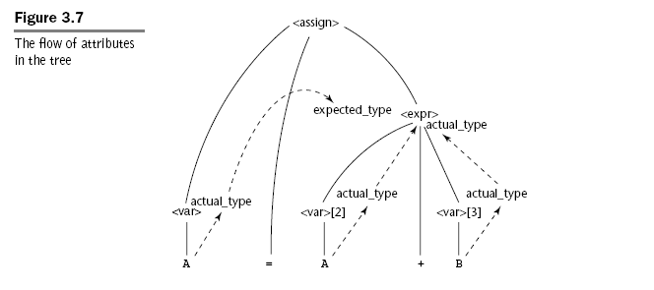
Attribute Grammars (continued)
Solid lines: parse tree
Dashed lines: attribute flow in tree
3-‹#›

Slide 42
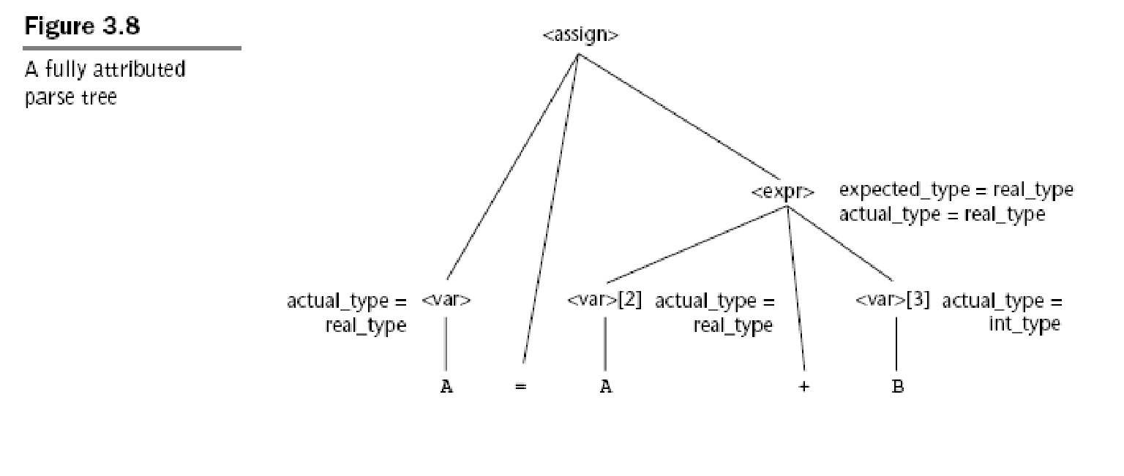
Attribute Grammars (continued)
3-‹#›

Slide 43
Summary
BNF and context-free grammars are equivalent meta-languages
Well-suited for describing the syntax of programming languages
An attribute grammar is a descriptive formalism that can describe both the syntax and the semantics of a language
3-‹#›

